Slide 1
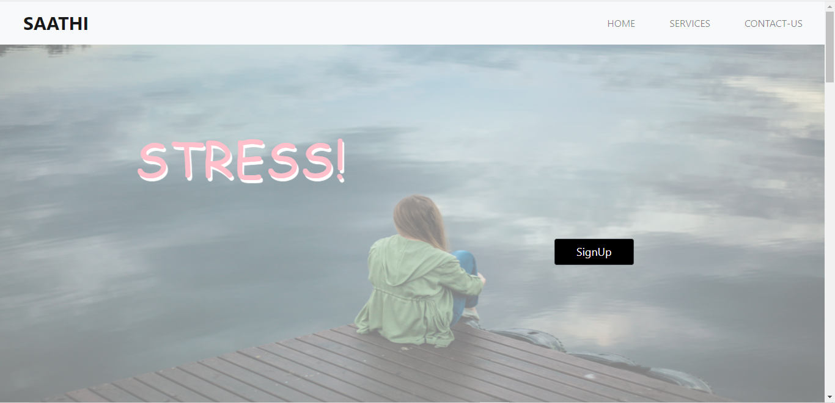
MENTAL HEALTH AND PSYCHOLOGICAL SUPPORT APP:SAATHI
Presented By :
Team Mythical Techies
Chandigarh Engineering College,Landran.

Slide 2
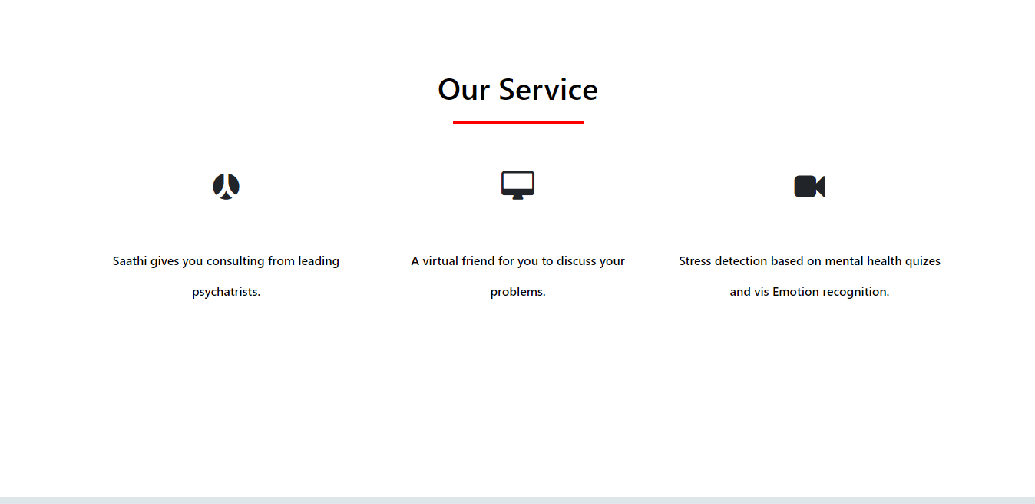

Slide 3
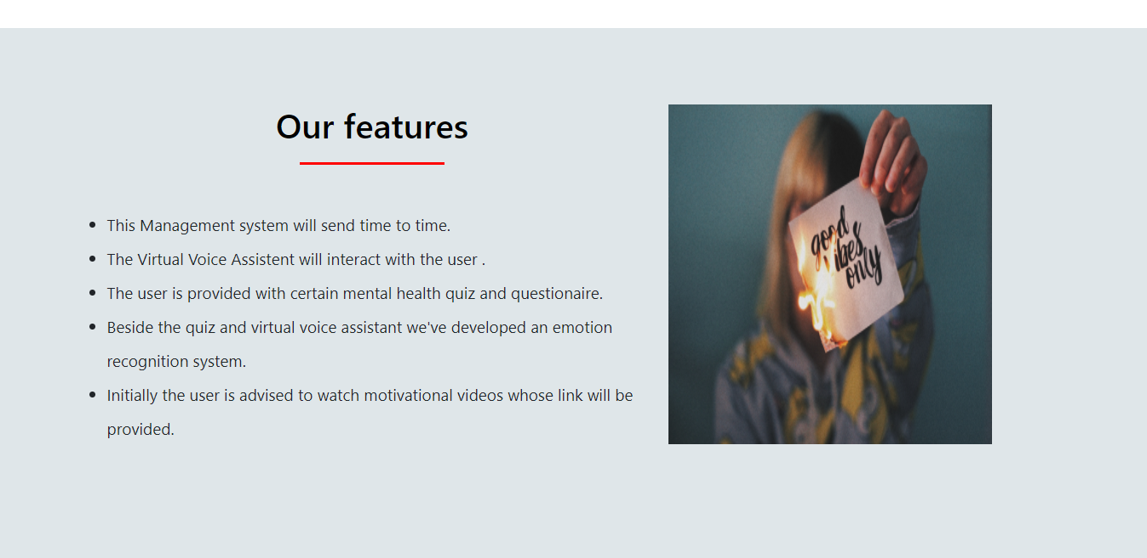
Why a person should use this app?

Slide 4
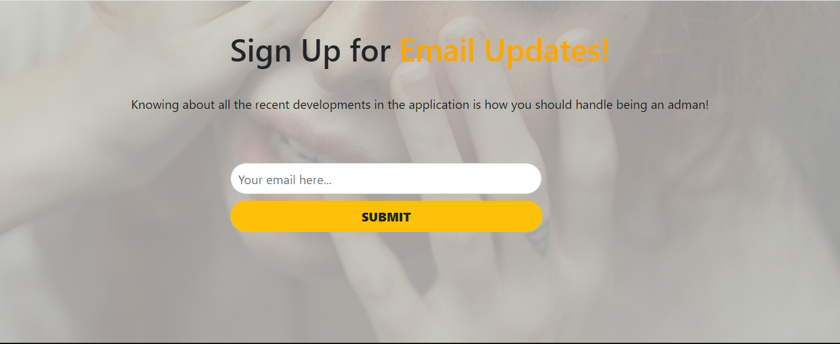
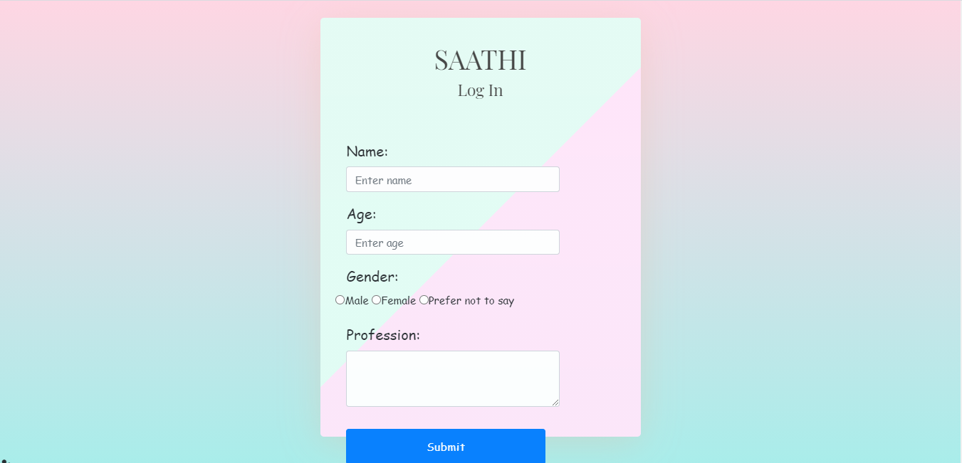
1)Notification System:
This notification system will send time to time notifications to the user by asking the following questions:
Ques1.How was your day?
Ques2.Do you neeed any kind of help?
Ques3.Do you wish to talk to someone and share your feelings?
Ques4.What can I do to help you today?

Slide 5
2)Virtual Voice Assistant:SAATHI
The Virtual Voice Assistant will interact with the user in the following way:
1.What’s on your mind?- I’m fine. I just hate my life, as usual.I’ve had such a bad day
2.Do you want to talk about it? I’m here when you’re ready.-It's just that I feel like I'm not capable of anything. I'm unworthy.I'm really stressed, I feel like dying
3.What can I do to help today?-How will you help me ,I'm experiencing such a bad chain of events.
4.You’re not alone. I may not understand exactly how you feel, but you’re not alone.- Thank you, but you can't help me ,I've tried everything but I'm unable to do this. I can't do this. I feel like my head's going to explode.
5.That sounds like it’s really hard. How are you coping?- I'm unable to
6.I’m really sorry you’re going through this. I’m here for you if you need me.

Slide 6
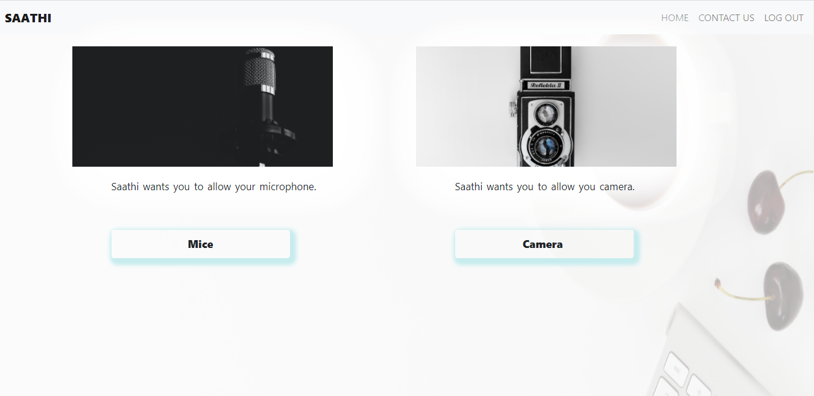

Slide 7
3)Quiz and Questionaire:
In this section the user is provided with certain mental health quiz and questionaire:
>Little interest or pleasure in doing thingsNot at all
Several days
More than half of the days
Nearly every day
>Feeling down, depressed, or hopelessNot at all
Several days
More than half the days
Nearly every day
>Trouble falling or staying asleep, or sleeping too muchNot at all
Several days
More than half the days
Nearly every day

Slide 8
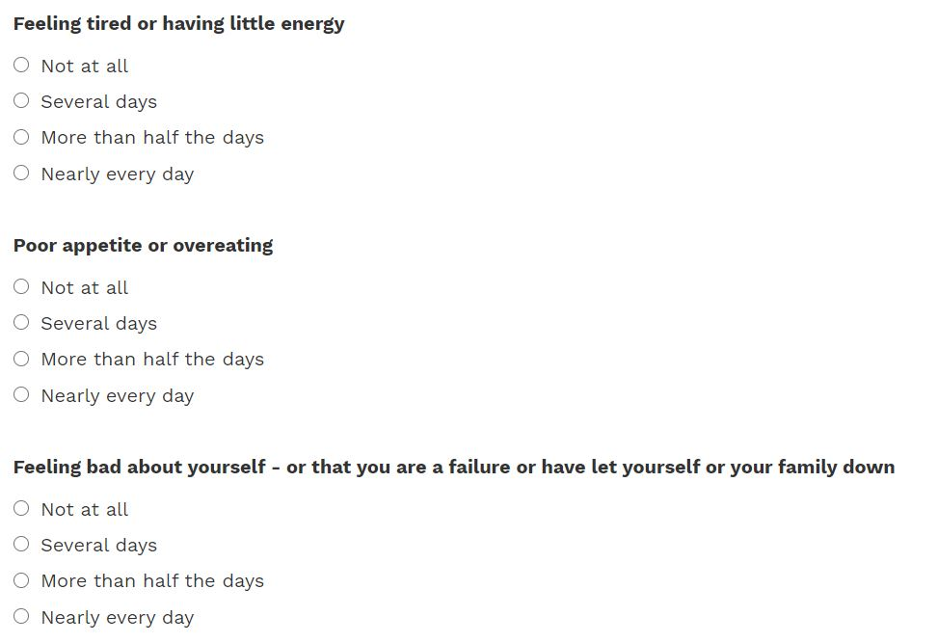

Slide 9
4)Emotion Recognition System:
>Besides the quiz and virtual voice assistant we’ve developed an emotion recognition system.
>It will detect the user’s face and provide us the information about how the user actually feels or what is his mood.
>The emotions are classified as happy,sad,neutral.
>If the user still feels sad or depressed the app will give the notification to consult a doctor or a psychiatrist.

Slide 10
5)Psychiatrist Consultation:
>Initially the user is advised to watch some motivational videos whose link will be provided.
>Then he is recommended with same basic home remedies which he can try on his own like doing meditation, practising yoga, indulging in any sports activity.
>If the user still is unable to cope up with his situation then he is advised to consult a psychiatrist.
>The consultation with a psychiatrist is implemented using WebRTC technology.

Slide 11
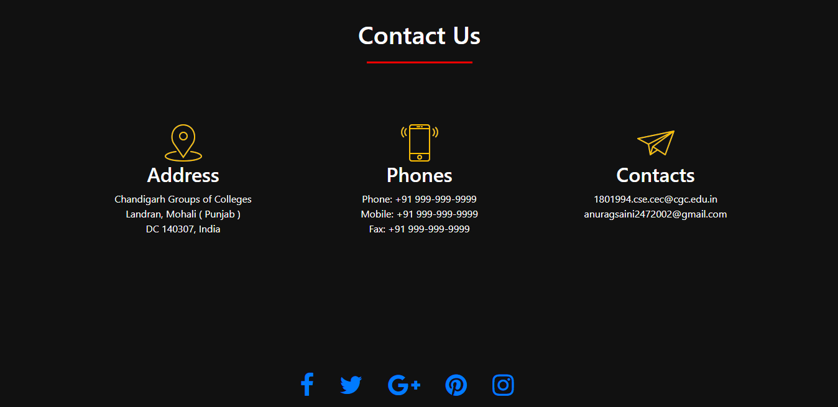
6)User Review:
>Hello, my name is Tanya Madan and I am a student of B.Tech CSE of Chandigarh Engineering College.
>We all go through a phase in life in which we always feel down ,we get sad and depressed, we feel ashamed of ourselves and our state in a way that we could not share it with anyone, I used the saathi app and I must say the experience was amazing .
>Their virtual assistant talks like a real person which made me feel at ease ,their stress recognition feature and the doctor consultation modules are cherry on the cake, I must say in future this project is going to prove itself extremely useful .

